Slide 1
OAKSIDE ELEMENTARY SCHOOL
SCHOOL LEARNING TEAM PRESENTATION
JANUARY 12, 2016
Staci Woodley, Principal
School Learning Team Members:
Jessica Newby, Nancy Castro, Tara Platt, Alexis Vazquez, and Michele Bass

Slide 2
A System Focused on
Every Student; Every Day
Reading
By the year 2020, all students (cohort 2014) will achieve grade level literacy by the end of grade 3
Graduation
By the year 2020, graduation rates will increase to 100%

Slide 3
Oakside Elementary
Demographic Data
Total Enrollment | 486
2nd Grade Enrollment | 215
3rd Grade Enrollment | 271
Number of Classes Per Grade | 11 – Grade 2 12 – Grade 3
Average Class Size | 20 students – Grade 2 24 students – Grade 3
English Language Learners | 164 (34%)
Special Education | 65 (13%)

Slide 4
Oakside Elementary 2nd Grade
Demographic Data
Total Classes | 11
Transitional | 1
Dual Language | 2
Transitional Bilingual | 2
ICT | 2
Self Contained 2/3 | 1
General Education | 4

Slide 5
Oakside Elementary 3rd Grade
Demographic Data
Total Classes | 12
Dual Language | 2
Transitional Bilingual | 1
ICT | 3
Self Contained 2/3 | 1
General Education | 6

Slide 6
Fountas & Pinnell Data
2nd Grade
Beginning of the Year
In Need of Intensive Support Level H and Below | Approaching Expectations Levels I – J | On Grade Level Levels K – L | Exceeds Grade Level Level M+
103 students | 41 students | 46 students | 32 students
Middle of the Year
In Need of Intensive Support Level I and Below | Approaching Expectations Levels J -K | On Grade Level Levels L - M | Exceeds Grade Level Level N+
83 students | 50 students | 37 students | 43 students

Slide 7
Fountas & Pinnell Data
3rd Grade
Beginning of the Year
In Need of Intensive Support Level K and Below | Approaching Expectations Levels L – M | On Grade Level Levels N – O | Exceeds Grade Level Level P+
125 Students | 71 students | 23 students | 27 Students
Middle of theYear
In Need of Intensive Support Level L and Below | Approaching Expections Levels M – N | On Grade Level Levels O – P | Exceeds Grade Level Level Q+
115 Students | 55 students | 51 students | 39 Students

Slide 8
Action Plan
  Inspire love for reading through teacher enthusiasm, school incentives and interactive lessons.
  Provide differentiated reading instruction driven by assessment data.
  Conduct individual teacher data meetings
  Use a balance of complex poetry, fiction and non-fiction texts during whole class instruction.
  Implement a Reader’s Workshop Model in every classroom.

Slide 9
Action Plan
Develop a community of reciprocal teaching and learning
  Staff led and planned presentations including:
    Modeling components of Reader’s Workshop
    Demonstrating proper technique for using the F&P benchmark assessments
    Explicit teaching to the Lesson Planning Template for Guided Reading.
    Training on ways to use the miscue analysis to drive instruction
    Literacy Leaders and Reading Teachers facilitating faculty conferences
    Teacher participation in book study discussion Explicit Direct Instruction for English Learners by John R. Hollingsworth and Silvia E. Ybarra
    ICT Training
    UCLA Walkthroughs
    Team Meetings

Slide 10
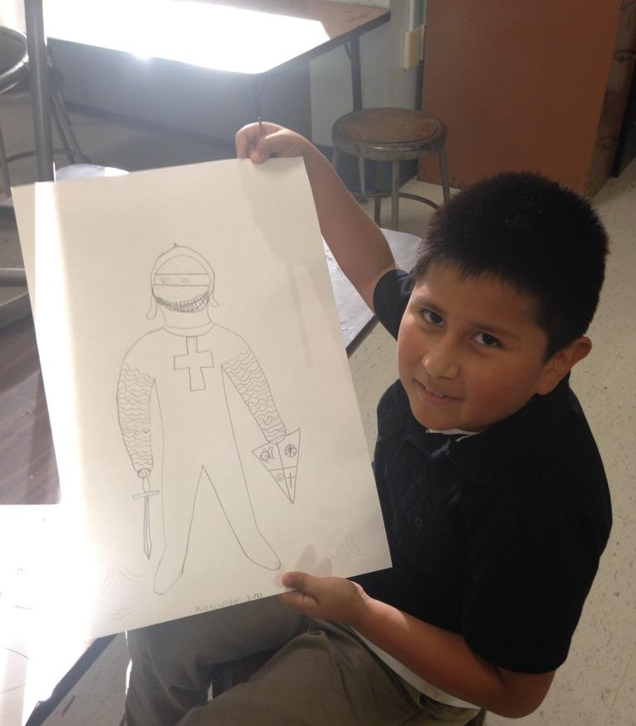
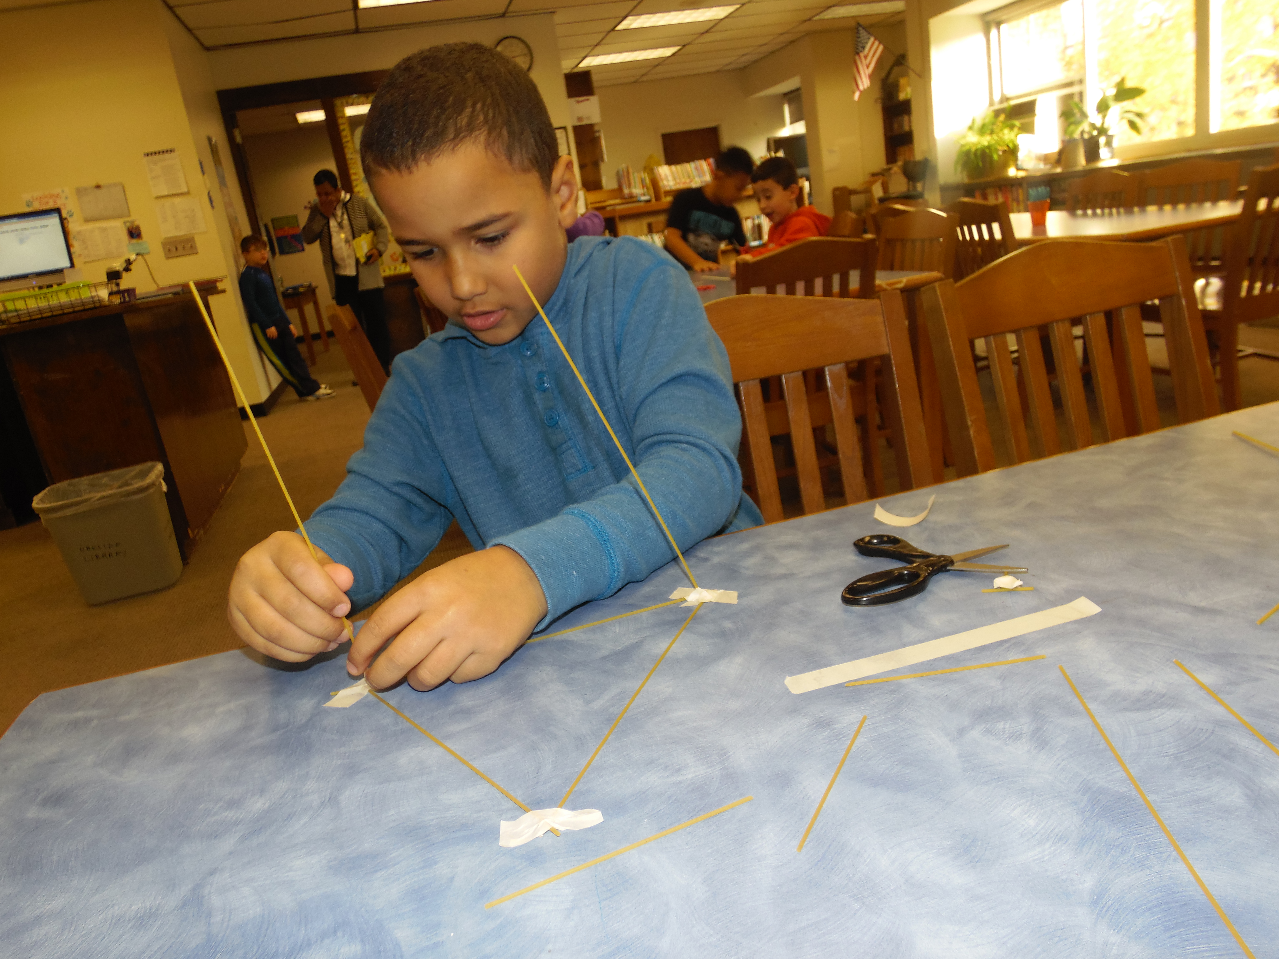
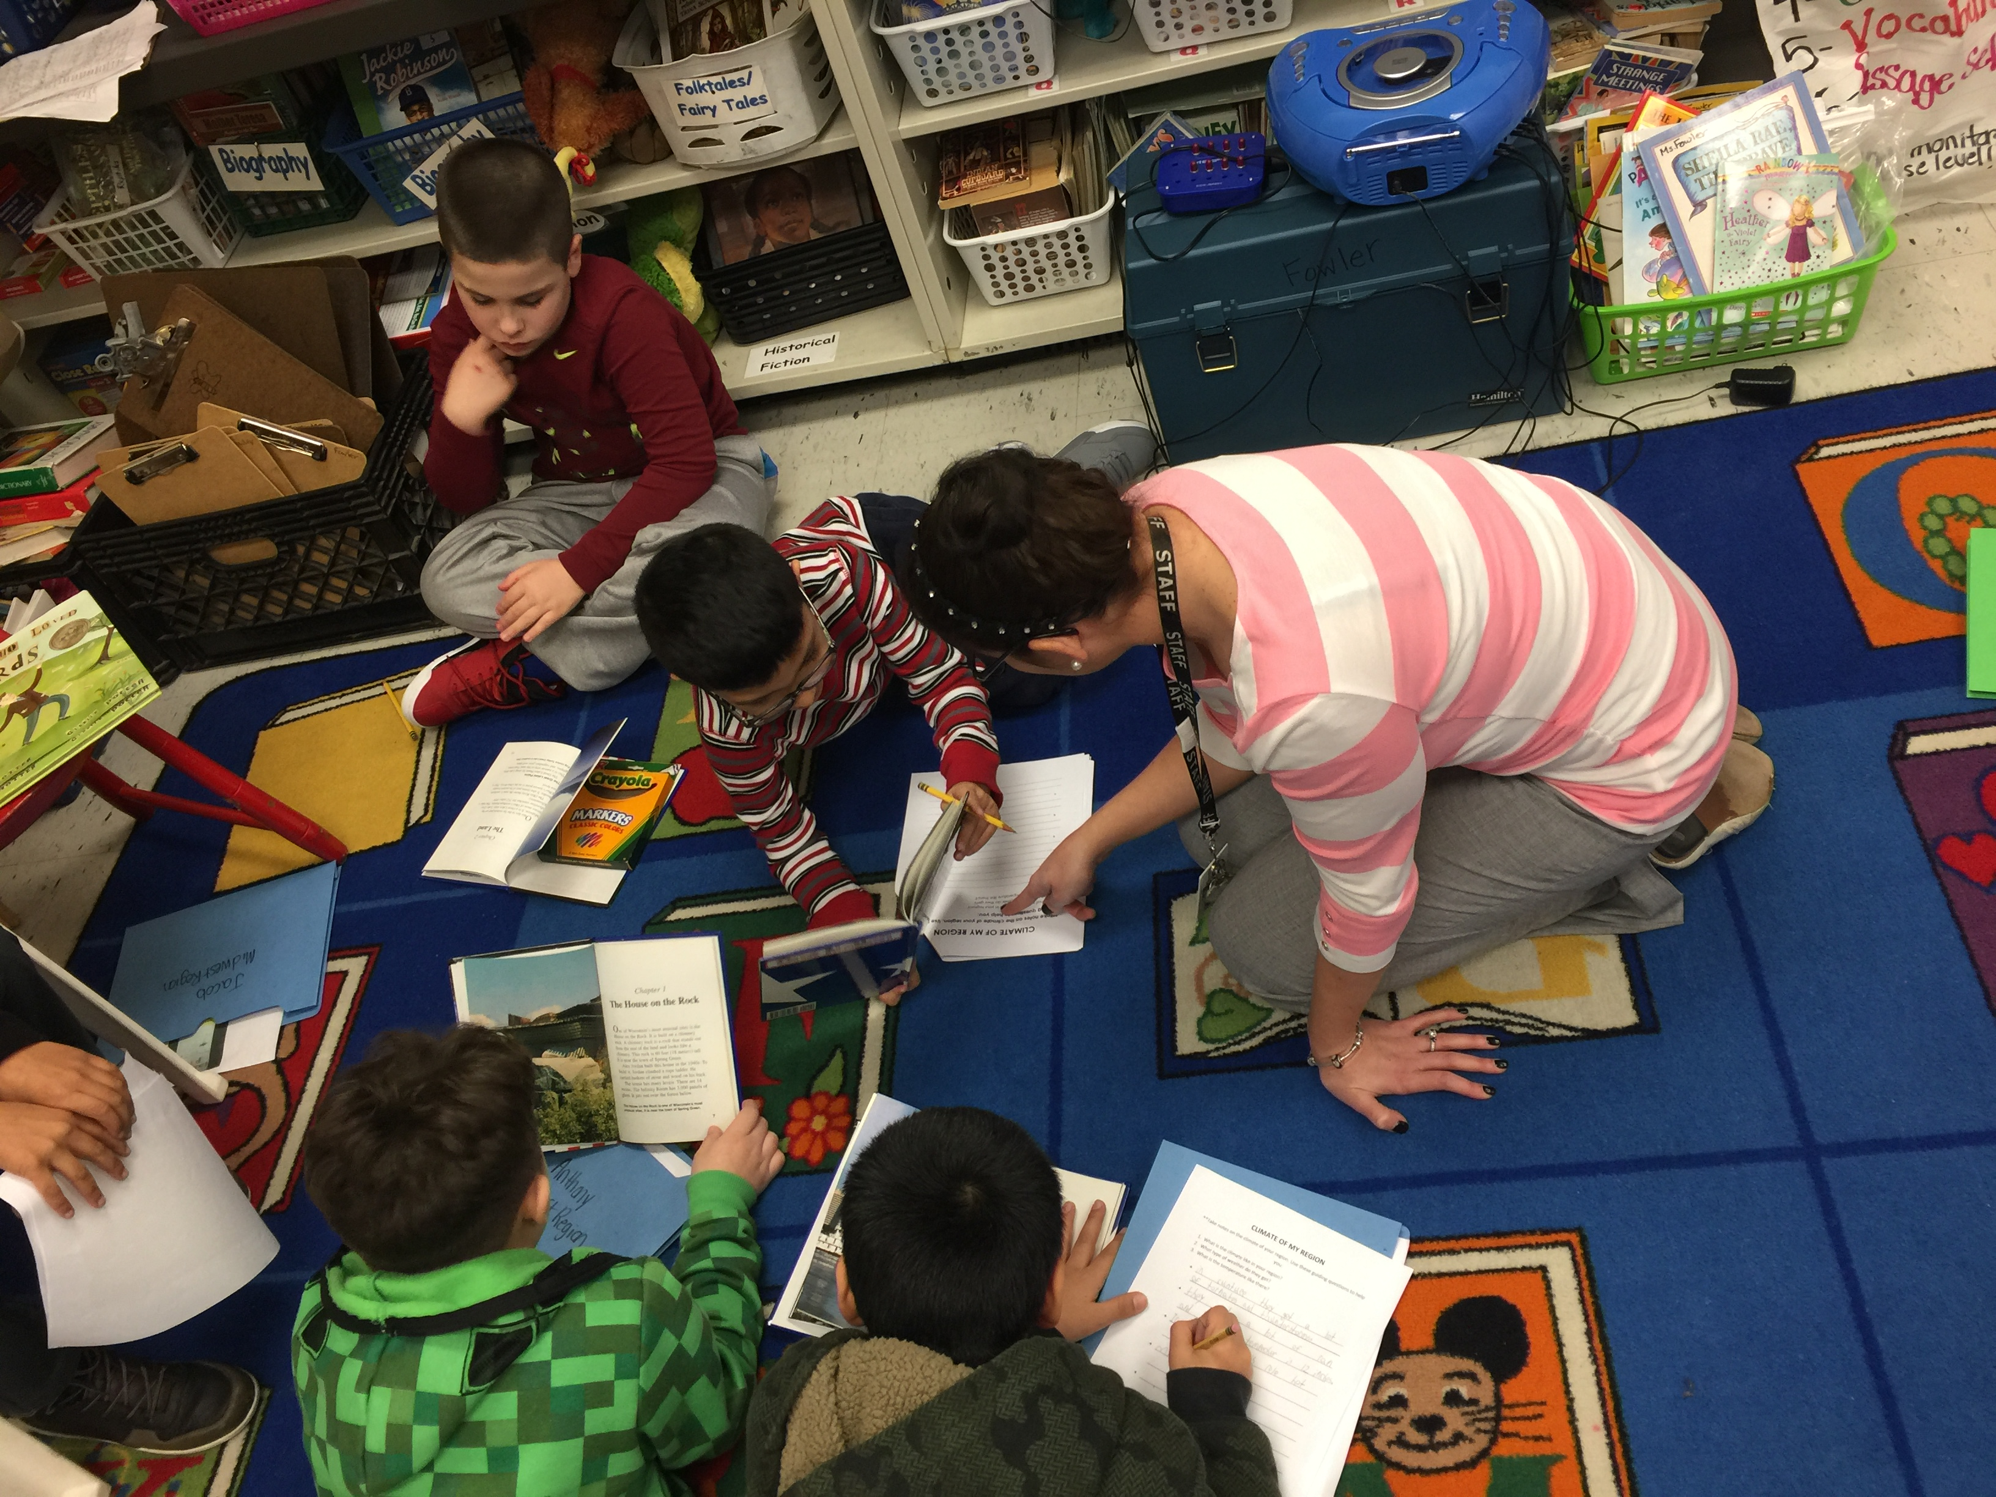
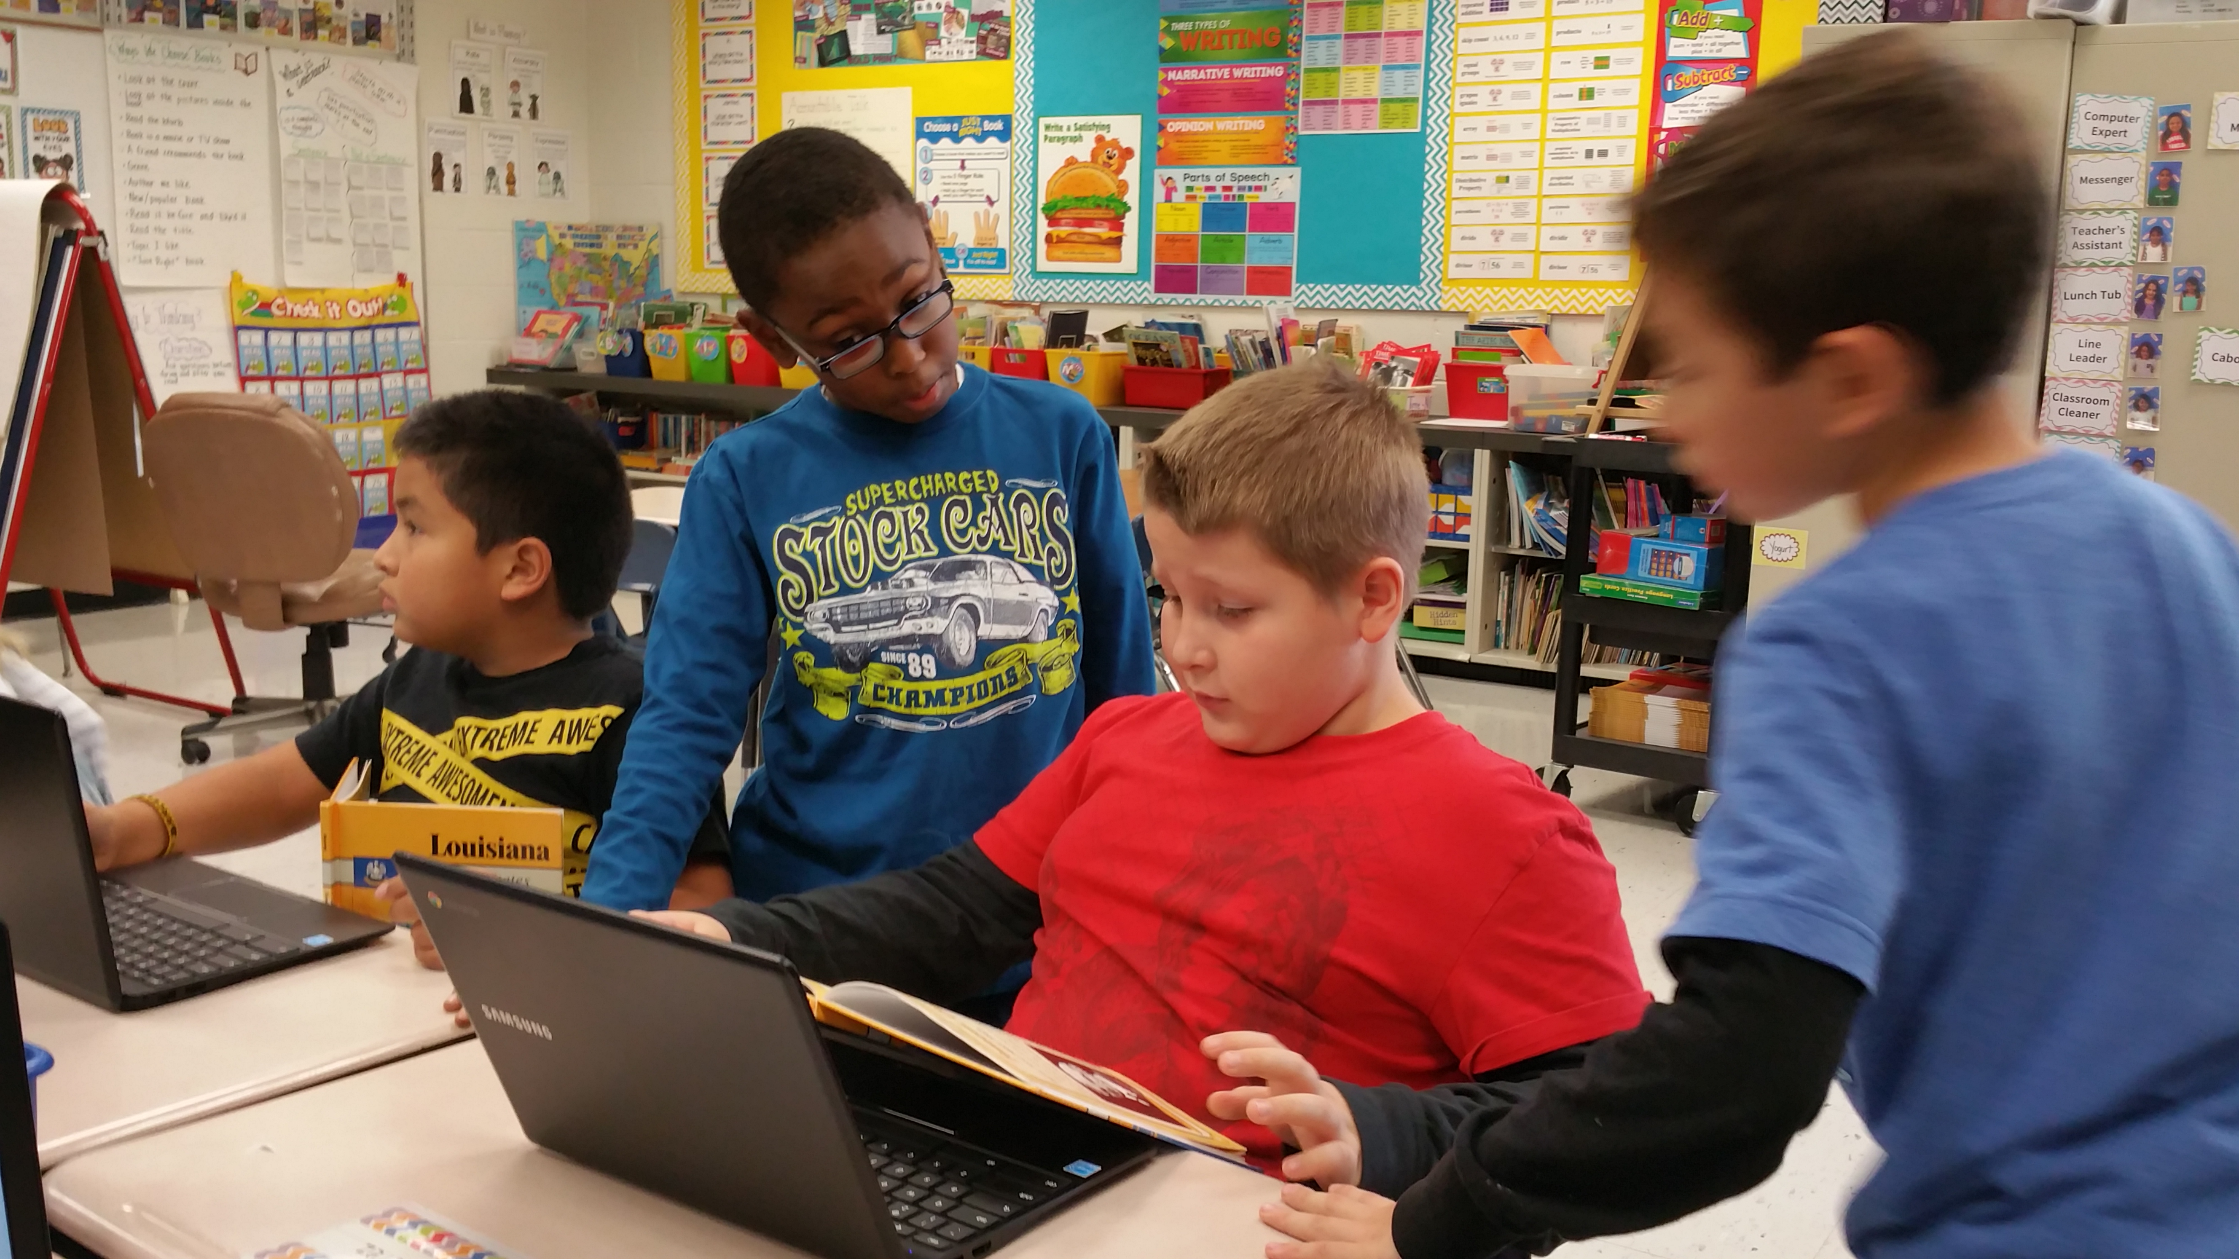
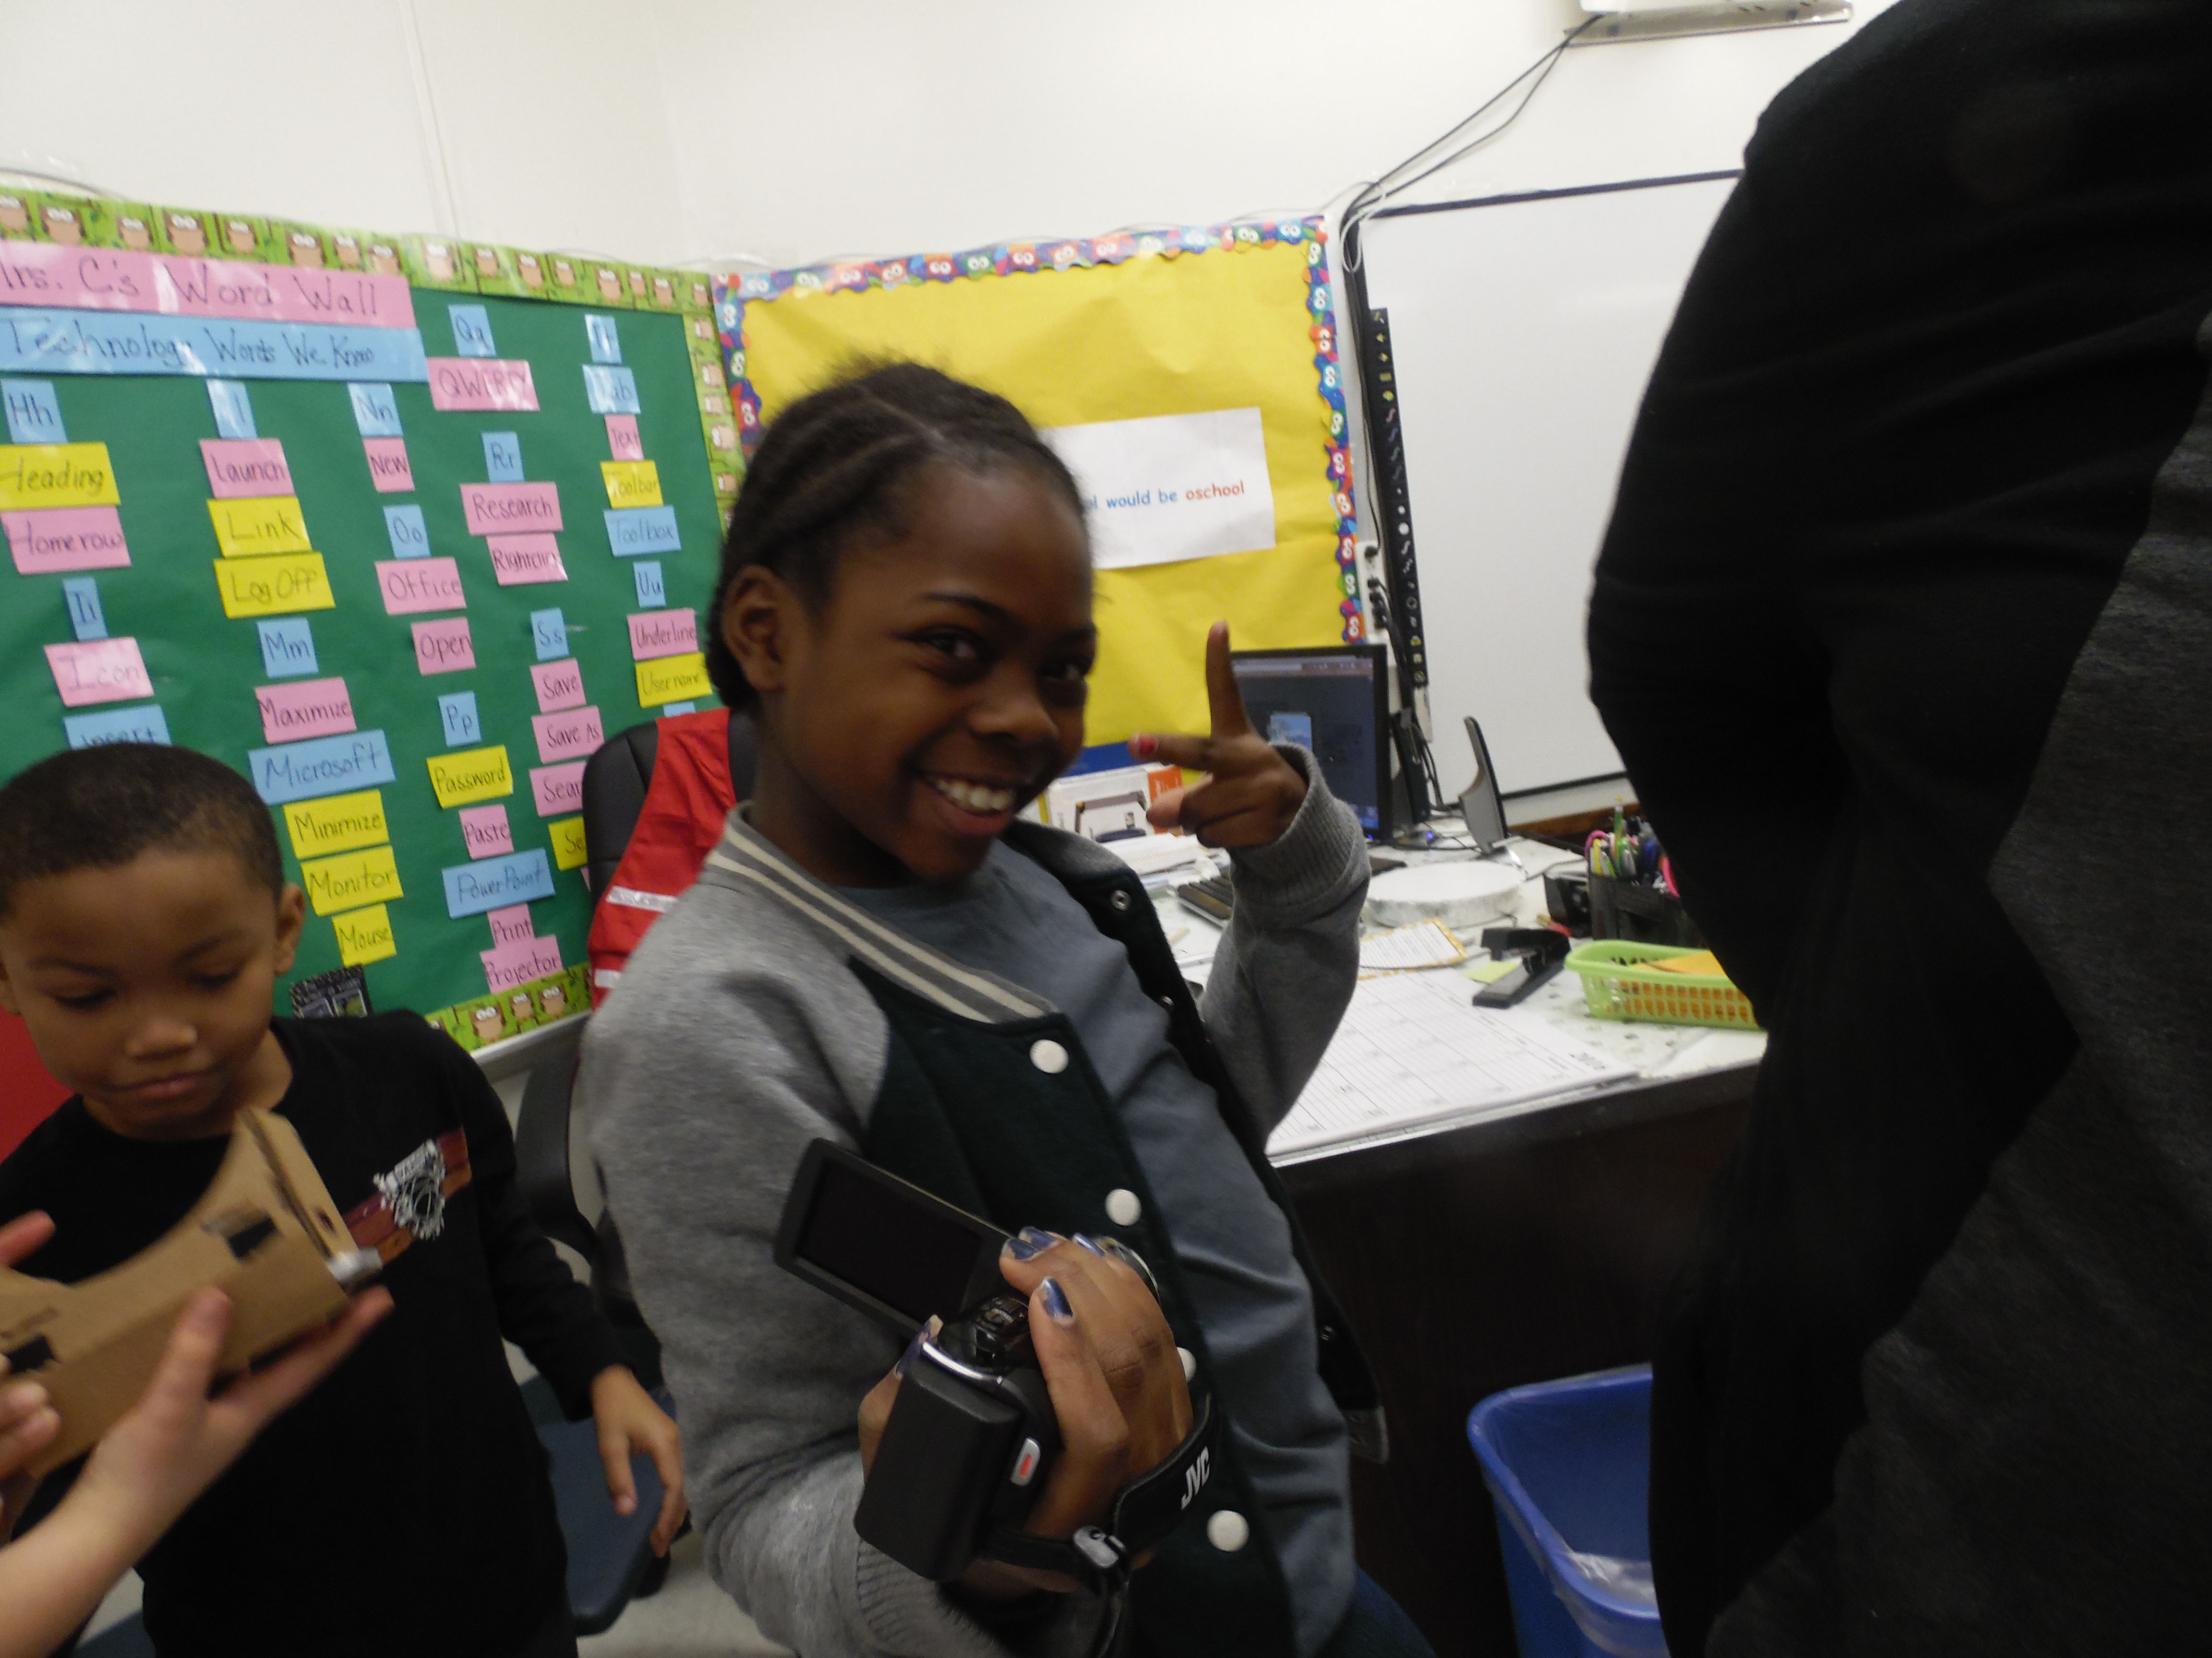
Enrichment
Library/Media Specialist Enrichment
Art Enrichment
Geography studies: Students work in groups to research one of the five regions of the United States
The S.W.A.T Team assisted with Chrome Books
Creating videos to educate our peers on Digital Citizenship

Slide 11
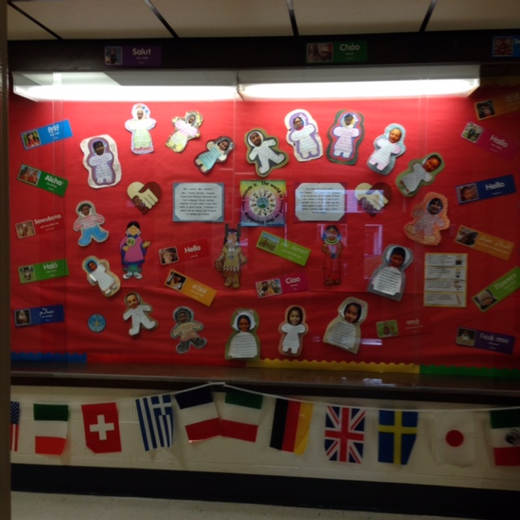
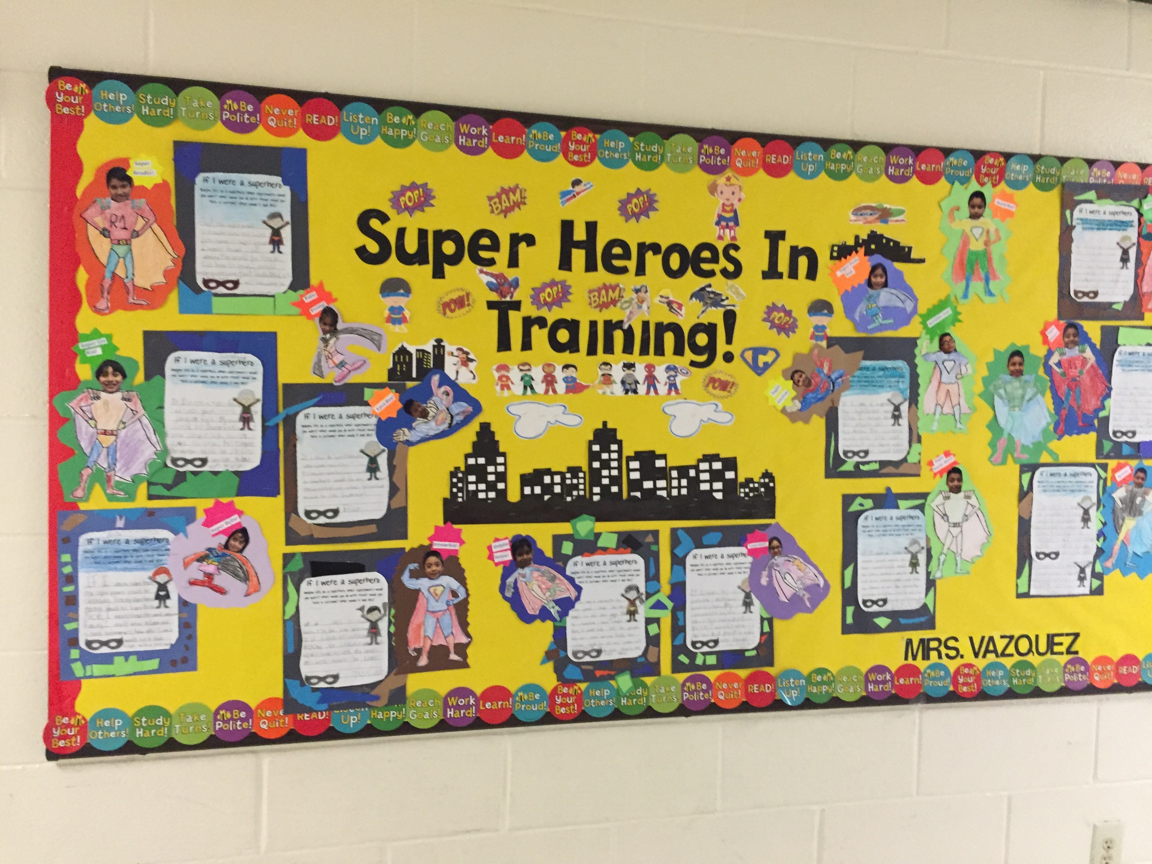
Support and Partnerships
CUNY – NYSIEB (New York State Initiative on Emergent Bilinguals)
Guidance Counselor
Arts 10566
Sanctuary
WJCS
Good News Club
Barnes and Noble Fundraiser
Field Library Collaboration

Slide 12
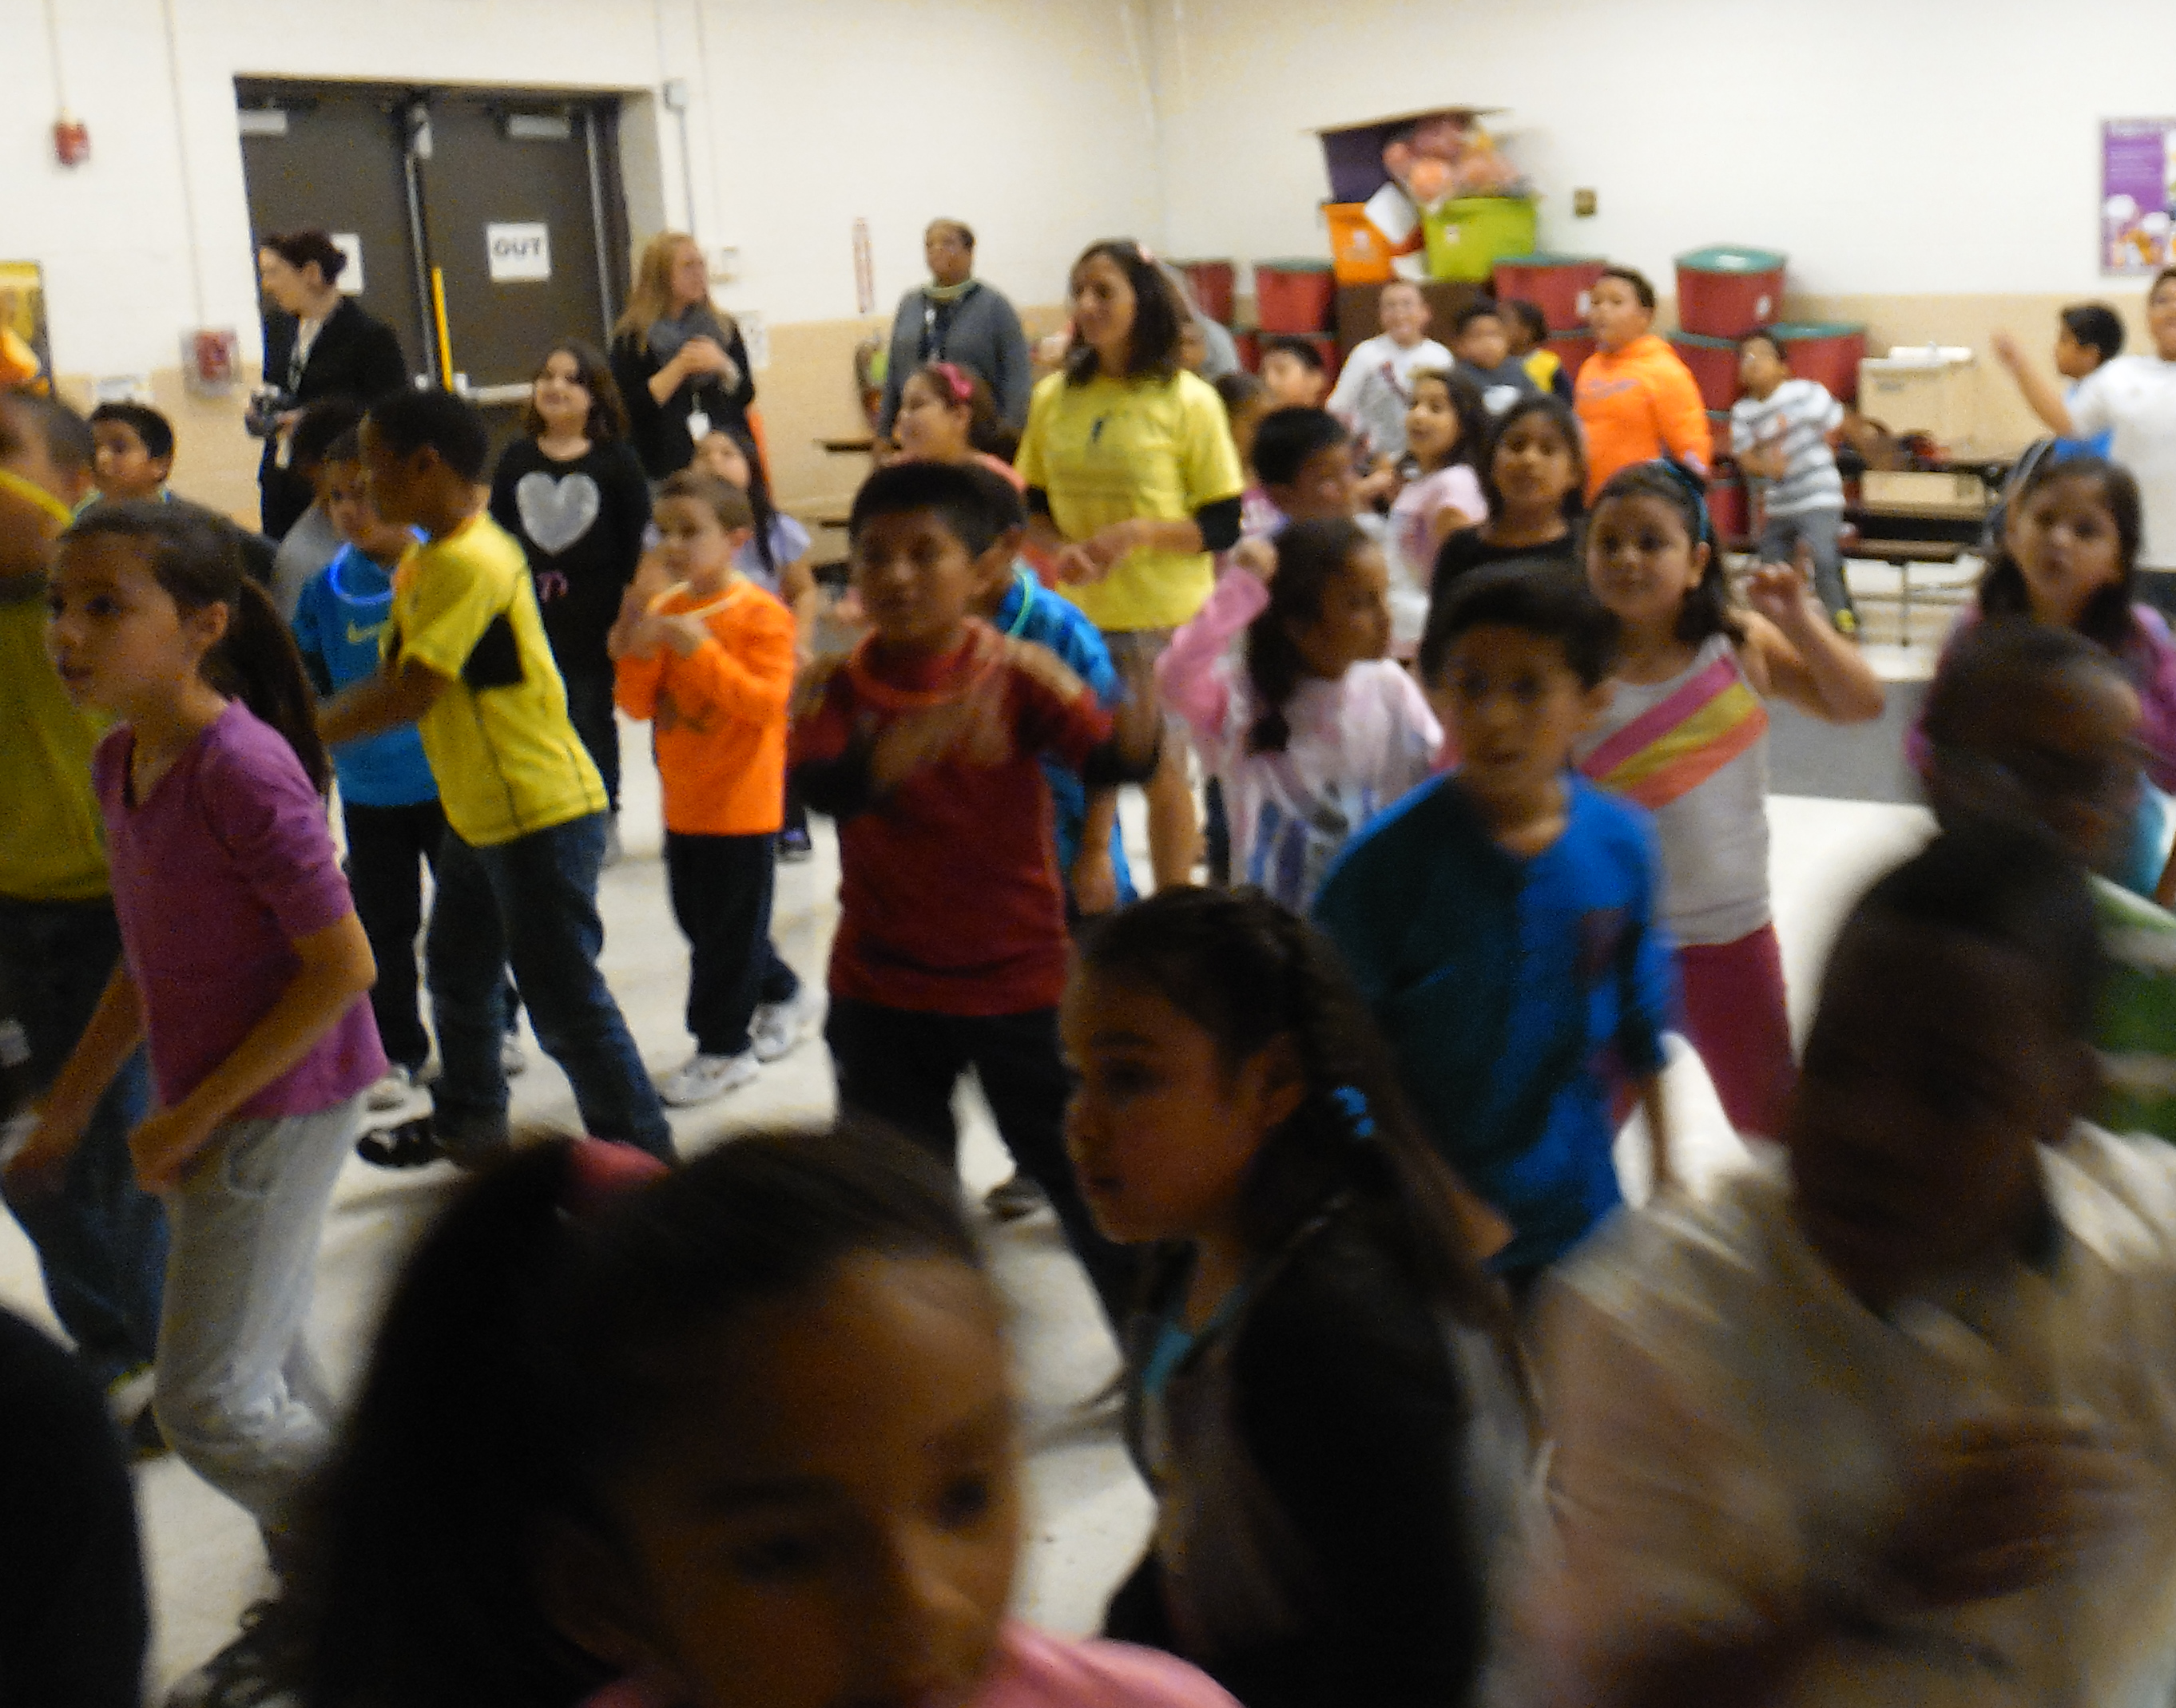
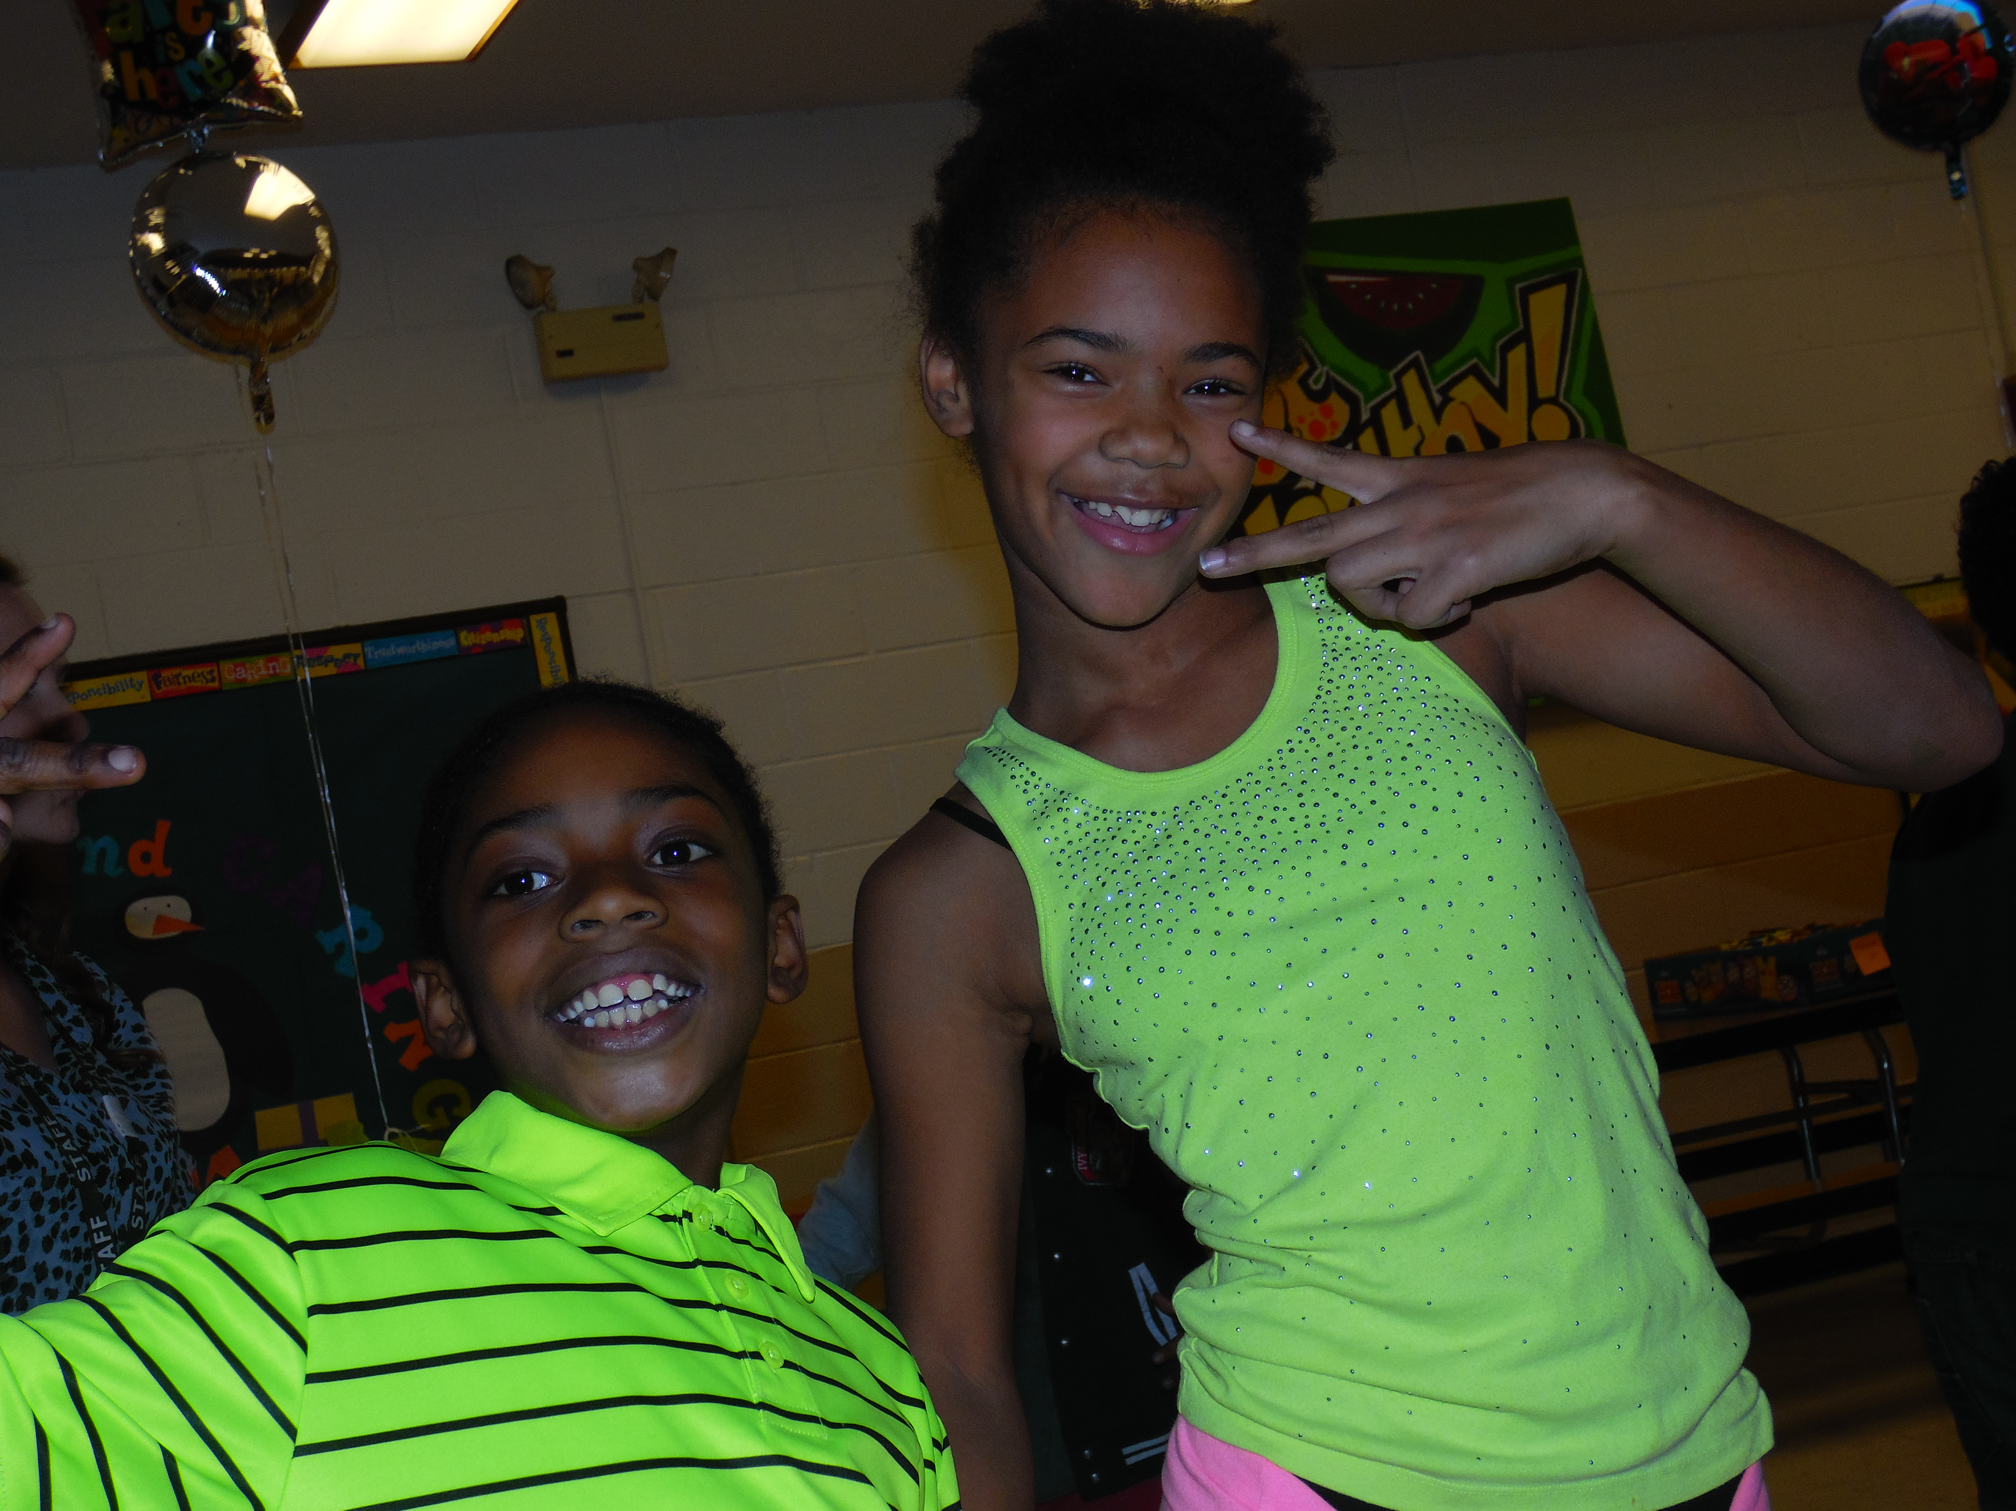
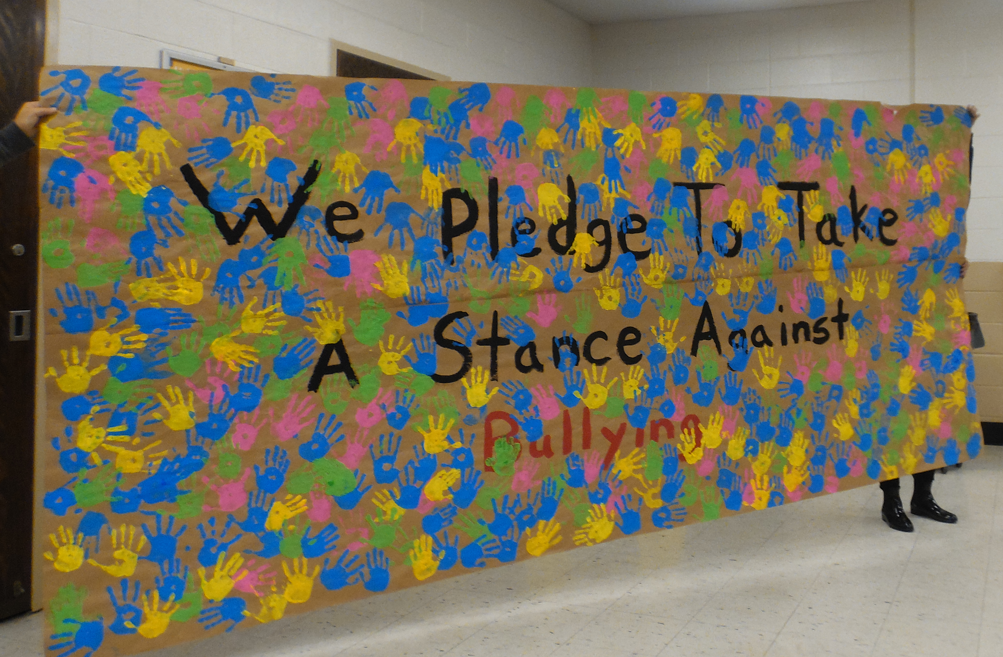
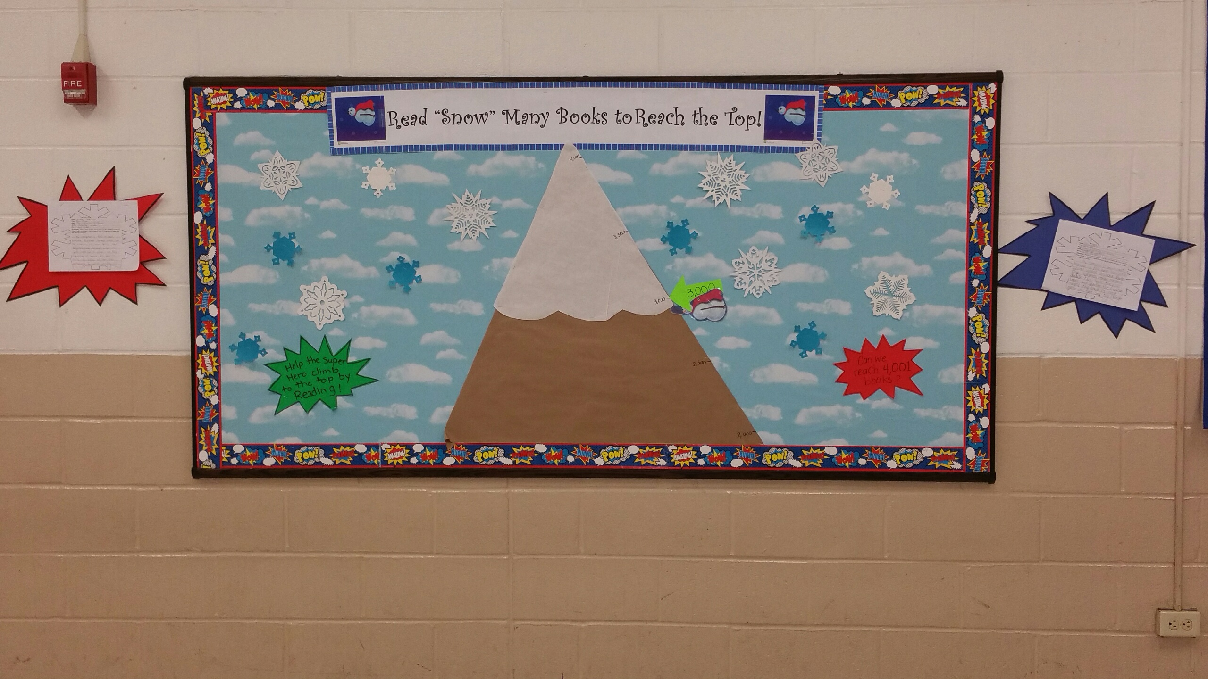
Celebrations and Family Involvement
Celebrations, Incentives and Family Workshops
  Summer Reading Challenge Celebration
  School wide Reading Challenge/2000 Books read quarterly (Celebrations, Book Bursts displayed, and Monthly Super Reader recognition)
  Scholastic Book Fair
  Family Literacy/Math Nights
  Family Literacy Celebrations (individual classrooms)
  PBIS (Positive Behavior Intervention Services

Slide 13
THANK YOU
Stay tuned for more POWerful work!

